Slide 1

Crafting a good portfolio & Choosing the right tool as a Data Analyst
Adeola Lawal

Slide 2


Slide 3

What is a Portfolio?
A data science portfolio can contain many things but typically revolve around the things that you, the data science professional, have created. Examples are building an algorithm from scratch, researching new methods, doing meaningful analyses, etc. It allows you to demonstrate the expertise that you focus on in personal projects.

Slide 4
Why is a portfolio important as a data analyst?
As you begin your data analyst job search, your portfolio will be one of the most important aspects of your application. Your portfolio showcases your skills at work in the real world. This validates your skills to recruiters, hiring managers, and potential clients in a way that's hard to do with a resume alone.

Slide 5
How to build a data analytics portfolio
While you can list your data skills on your resume, it’s your portfolio that provides the proof. In its simplest form, a portfolio is a collection of data projects you’ve worked on. Let’s take a closer look at how to build one.

Slide 6
Portfolio Platforms
The first step in building a data analytics portfolio is choosing where to host it.
You don’t have to spend a lot of money or build your own website from scratch, either. When you’re just getting started, consider these free portfolio website options:

Slide 7

Portfolio Platforms
LinkedIn: LinkedIn makes it fairly easy to add, update, and remove projects from your profile, which can double as an online portfolio. The platform supports a range of formats (.jpeg, PDF, PowerPoint, Word, and others), so you can upload and share many types of content. With LinkedIn, you can add projects under your Featured, Experience, or Education sections.

Slide 8

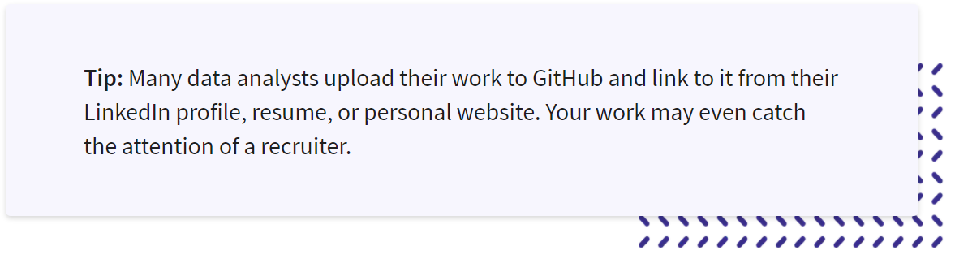
Portfolio Platforms
GitHub: Another popular option where you can host your portfolio for free is GitHub, an open-source community of some 56 million developers. Once you create an account, you can start adding data projects to a public repository, where you can show off elements like your code and Jupyter Notebooks.

Slide 9

Portfolio Platforms
Kaggle, a customizable Jupyter Notebooks cloud environment, can also serve as a free portfolio of your work. Here you can display results of any Kaggle data science competitions you take part in or showcase any data sets you’ve built or code you’ve written.

Slide 10
What to include in your portfolio
The contents of your portfolio are more important than where you choose to host it. A simple portfolio should include at least two sections, an “About me” section and data analytics projects. Let’s take a closer look at both.

Slide 11
About me
The “About me” page gives you an opportunity to introduce prospective employers to who you are, what you do, and why it’s important to you. You can use this section to explain:
How you got started in data analysis
What about data interests you most
Where your passions lie in relation to data analytics
This is also a great place to include your contact details (if you don’t have them on a separate page) and links to your social media accounts.

Slide 12
Projects
The bulk of your portfolio will likely comprise a series of projects and case studies that demonstrate your key skills. In general, your portfolio should showcase your best or latest work. Try to include projects that highlight your ability to:
Scrape data from websites: Show your code and use hashed comments to explain your thinking.
Clean data: Take a dataset with missing, duplicate, or other problematic data, and walk through your data cleaning process.
Perform different types of analysis: Use data to perform diagnostic, descriptive, predictive, and prescriptive analysis.

Slide 13
Projects
Visualize data to tell a story: Create a chart, map, graph, or other visualization to make your data easier to understand.
Communicate complex ideas: Consider writing a blog post that outlines your process or explains a difficult data concept to highlight your communication skills.
Collaborate with others: If you’ve worked on a group project, be sure to include it.
Use data analysis tools: Share projects that show off your ability to use SQL, Python, R, Tableau, etc.

Slide 14
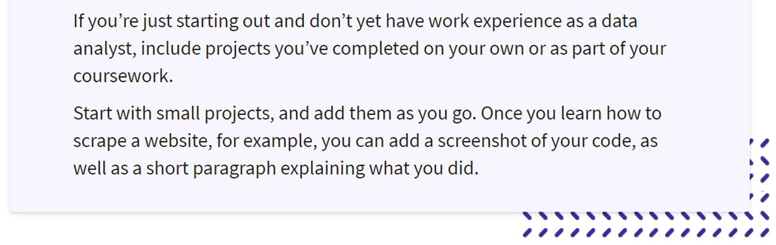
What do I put in my portfolio if I don’t have work experience

Slide 15
Other items to include
While you’ll definitely want to include an “About me” section and some projects, you can also build out your portfolio with a couple of other elements.
Blog: As you work on projects, consider writing blog posts about your process and findings. This can be an excellent way to showcase your communication skills while reinforcing your learning.
Testimonials: If you can gather a few quotes from professors, employers, clients, or colleagues about your work in data analytics, it’s a good idea to include them.

Slide 16
Data analyst portfolio tips and best practices

Slide 17
Use your portfolio to demonstrate your passions.
Your portfolio is an excellent spot to communicate what gets you fired up. Passionate about cryptocurrency? Prioritize projects using blockchain data. Interested in a job in the health care industry? Include health informatics projects.
Take advantage of tools like Jupyter Notebook and R Markdown.
Humans are visual creatures, so try to make your portfolio more than just a wall of text. One way to do so is by using R or Jupyter Notebooks. These web applications allow you to share your live code, visualizations, and text in an interactive way.

Slide 18
Only include your best work.
When it comes to your portfolio, less is more. When you’re just getting started, you might include every project you’ve worked on. But as you gain experience, you’ll want to include just enough to demonstrate your skills.
Build your portfolio as you learn.
You don’t have to wait for your first job to start developing your portfolio. If you’ve taken classes in data analytics, chances are they included some assignments or course projects. Add those to your portfolio. If you’re learning independently, start completing small portfolio projects as you go. You’ll not only practice your new skills, you’ll have material for your portfolio.

Slide 19
Browse other portfolios for inspiration.
Spend some time looking at other data analyst portfolios. You might pick up some ideas for how to present a certain type of project or how to incorporate a certain skill.

Slide 20
Important Data Analysis Tools used in the industry

Slide 21



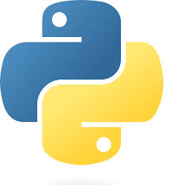
Should I focus on R or Python as a Data Analyst?

Slide 22


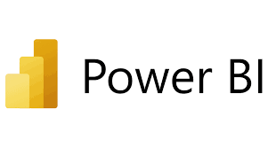
Should I focus on Power BI or Tableau as a Data Analyst?

Slide 23
Practical Session
Using data science tools for research dissertation and publication- Dr Rose
LinkedIn optimisation - Mr David

Slide 24
Thank you

